Slide 1
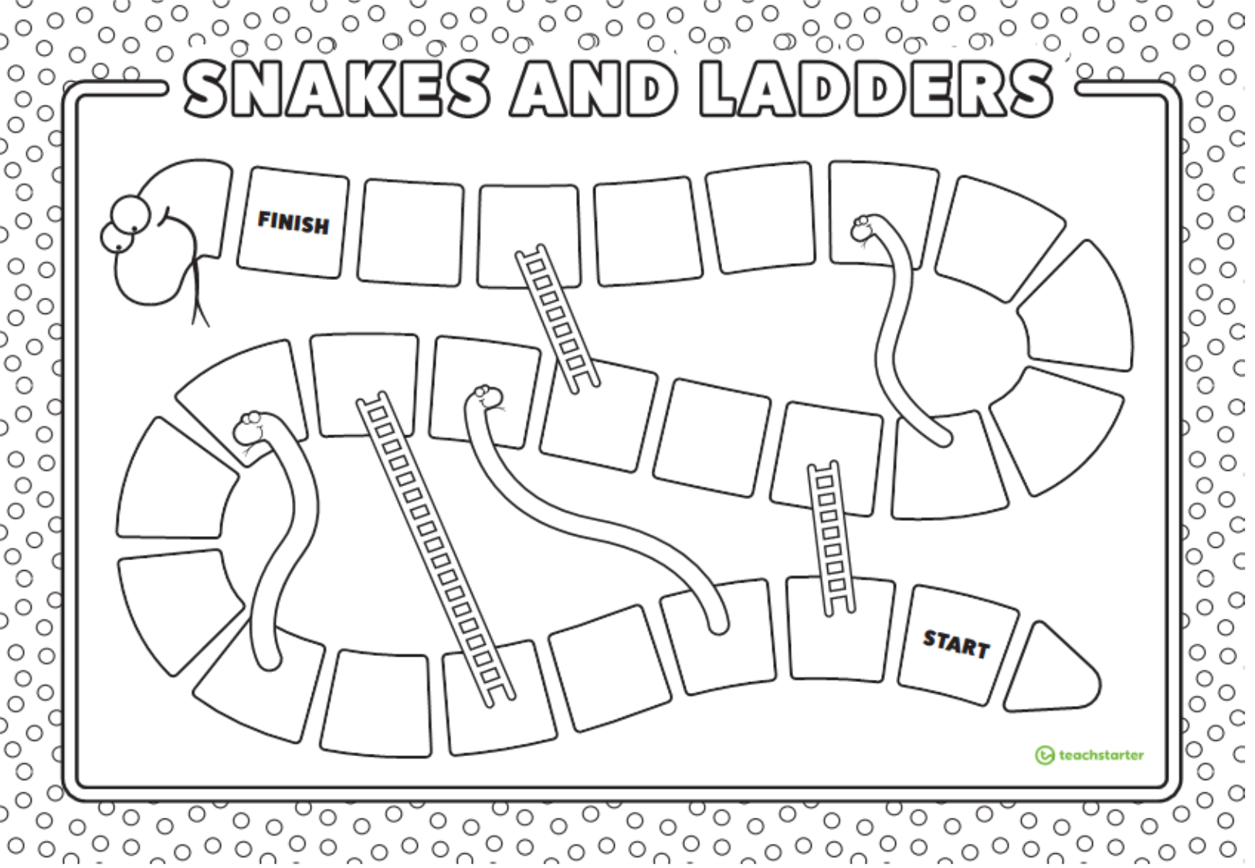
There are 3 board versions to the game: pictures only, words only, picture and words mixed.
We recommend photocopying onto A3 sized paper. We recommend using only 1 die to maximize playing time.
How to play:
Each player puts their playing piece on the space that says ‘START'.
Take turns rolling the die. Move your counter forward the number of spaces shown on the die.
The player then says the vocabulary word that corresponds with the picture on the square, or reads the word that appears on the square. More advanced students can also use the word in a sentence.
If your piece lands at the bottom of a ladder, you move up to the top of the ladder.
If your counter lands on the head of a snake, you must slide down to the bottom of the snake.
The first player to get to the space that says ‘FINISH' is the winner.

Slide 2

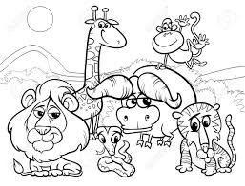


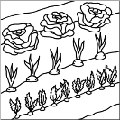

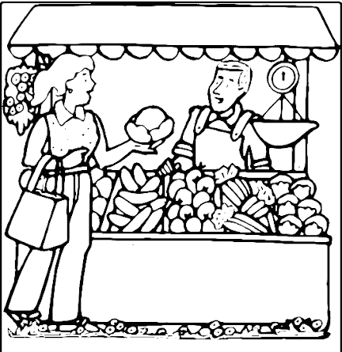

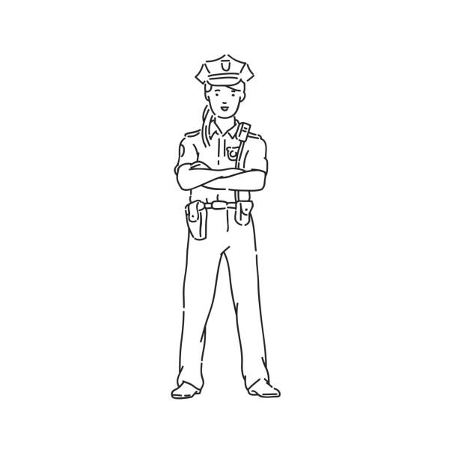
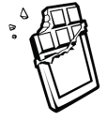


Lesson 81: Schwa Vowels
garden
police
pharmacy
animals
Idea
children
chocolate
hospital
market
opposite
terrible
Katie Hodari & Joanie Yogev

Slide 3
Lesson 81: Schwa Vowels
garden
police
idea
pharmacy
hospital
animals
children
terrible
idea
chocolate
hospital
market
pharmacy
reason
opposite
terrible
animals
Katie Hodari & Joanie Yogev

Slide 4


Lesson 81: Schwa Vowels
Katie Hodari & Joanie Yogev

