Slide 2
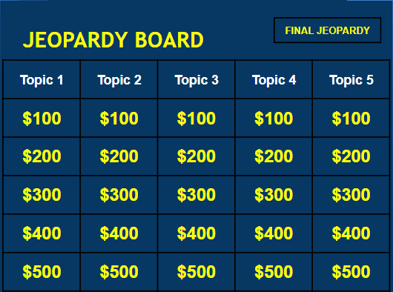
Consonants
Words

Slide 3
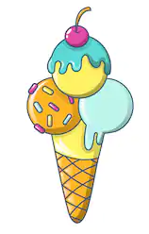
1_1

Slide 4
1_1
What is a
long “i” ( ī )

Slide 5
1_2

Slide 6
1_2
What is a
short “i” (ĭ)

Slide 7
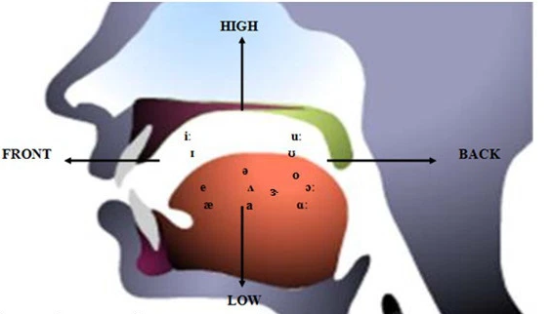
1_3
What is a vowel

Slide 8
1_3
To say it, you need to open your mouth and your tongue cannot touch anything inside

Slide 9
2_1

Slide 10
2_1
What is the letter “t”

Slide 11
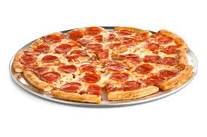
2_2

Slide 12
2_2
What is the letter “p”

Slide 13
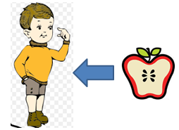
2_3
Added to the end of a word to show belonging

Slide 14
2_3
What is
‘s

Slide 15
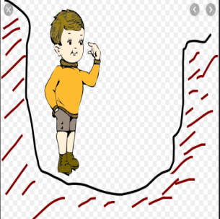
3_1

Slide 16
3_1
What is
“p” “i” “t”

Slide 17
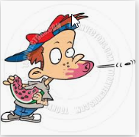
1_1

Slide 18
1_1
What is
“s” “p” “i” “t”

Slide 19
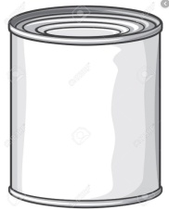
3_3
You add this to the end of a word to make it into lots (plural)

Slide 20
3_3
What is the letter
“s”

