Slide 1
Reverse Trivia, by Jason Zepp, Tamar Silverman, Meir Morozov Reading, writing, guessing words from Lesson 9
Instructions
Teacher projects PowerPoint slides onto white board.
With colored whiteboard markers, draw "machberet chachama" lines beside the slides, where players can write their answers. Keep markers available.
Divide class into 2 teams. Teams take turns.
A student calls out a column letter (A, B, C, D) and 100, 200, or 300; point level refers to easier or harder clues.
Teacher clicks on choice, which is hyperlinked to a slide with a clue.
A student from the team is elected to come to the board to write the word matching the clue on a "machberet chachama" line.
The team can help, or call out, to correct error in spelling.
Points are tallied.
Teacher clicks on the clue slide, to get back to the first scoreboard slide. (The links that have already been used will change color.)
List of answer words:
trap, crab, red, Arab
crib, rat, rip, print
rind, pretend, there/their, ran
Teacher can adapt and modify his/her selection of vocabulary and create new clues to use the format of the game for other lessons.

Slide 2
Reverse Trivia
A
B
C
D
100
100
100
100
200
200
200
200
300
300
300
300

Slide 3
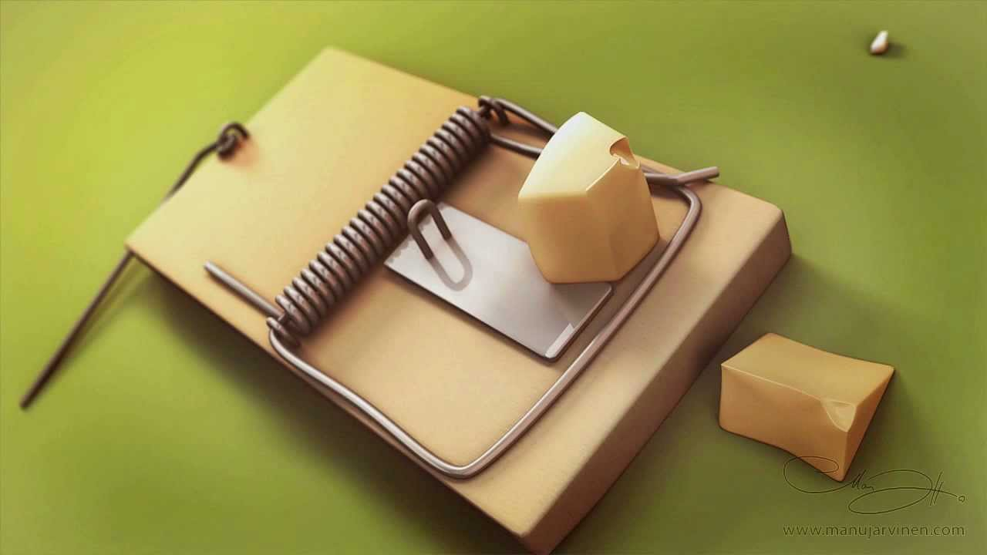

Slide 6
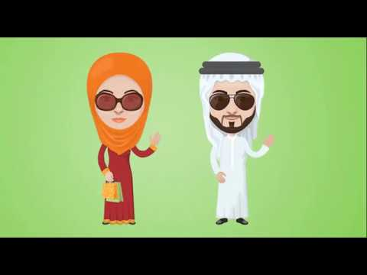

Slide 7
עריסה

Slide 8
עכברוש

Slide 9
לקרוע

Slide 10
הדפס

Slide 11
This is the peel of a fruit, the part you throw away before eating the fruit. Begins with ‘R’.
“R”
חלק מהפרי, הקליפה. מתחיל ב-
CONTINUE - המשך

Slide 12
Another word for make-believe.
Actors do this.
7 letter word beginning with “Pr”
להעמיד פנים, להתאמר.
שחקנים עושים את זה בסרטים.
מתחיל ב -
.“Pr”
CONTINUE - המשך

Slide 13
2 words that both begin with “th”.
They are homophones. They sound the same but mean different things.
“th”שתי מילים שמתחילות ב-
הן "הומופונים" שפירושו מילים הזהות בהגייתן אך שונות בכתיב.
CONTINUE - המשך

Slide 14
The past tense of “run”.
רץ בזמן עבר.
CONTINUE - המשך

