Slide 1


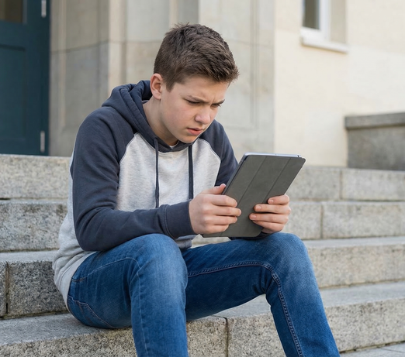
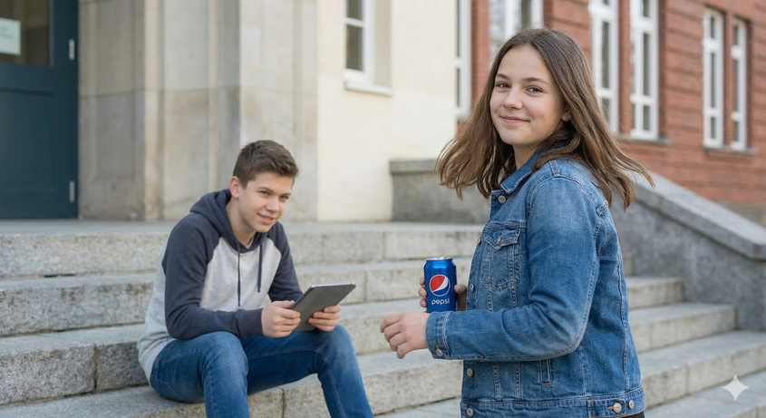
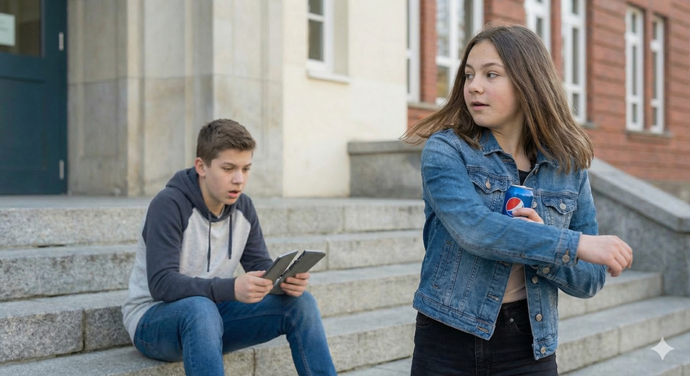
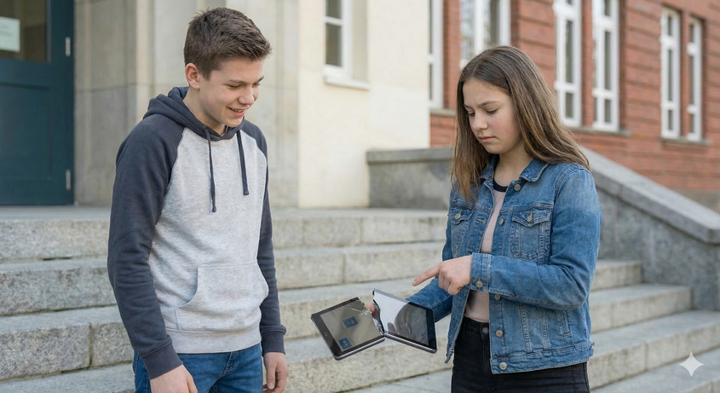
Lesson 5, letter e, sh by: Maya Harel and Haneen Badarnehs
Ted and his IPad
1
It is past ten. Ted has a test.
He sits at the steps.
The iPad is in his hand.
He taps "send."
2
Pat steps in.
She has a Pepsi.
She spins and hits the iPad.
3
The iPad snaps!
4
Ted stands. Pat is sad
Pat said: “The iPad! The iPad!”
Ted isn’t sad.
His test is in.

Slide 2
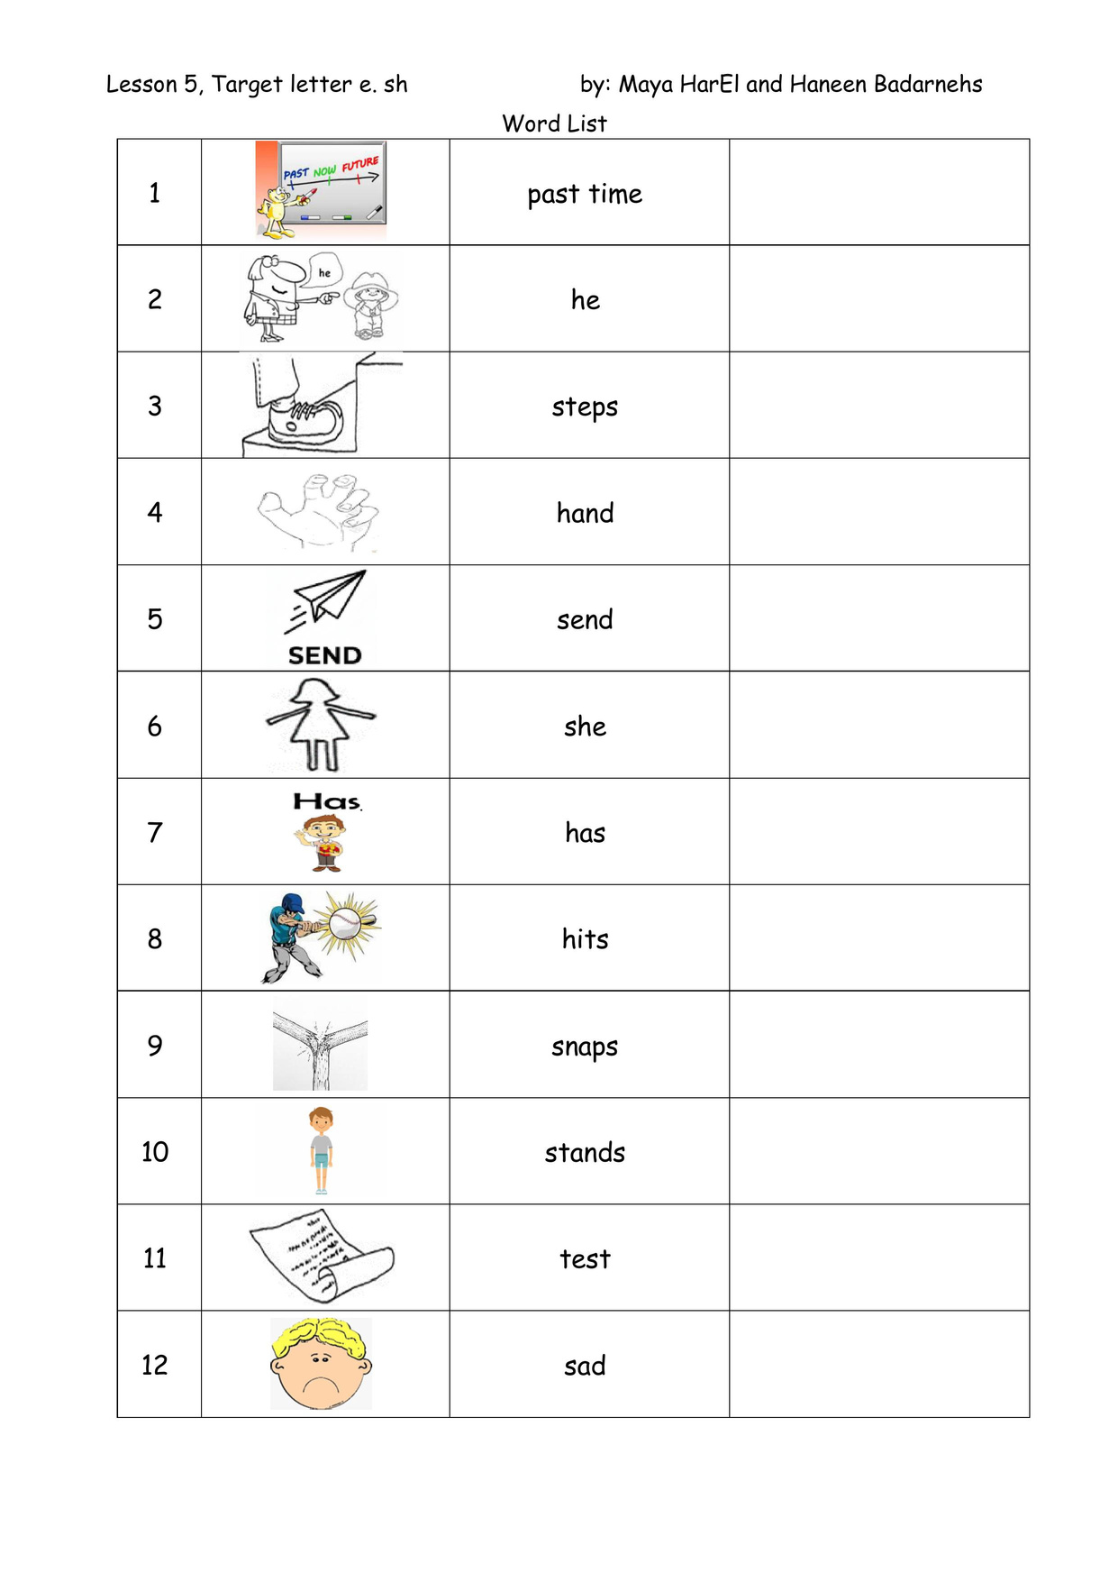
Lesson 5, letter e, sh by: Maya Harel and Haneen Badarnehs

Slide 3
Lesson 5, letter e, sh by: Maya Harel and Haneen Badarnehs
Online game:
https://wordwall.net/resource/108192376/word-practice-lesson-5
Bottle Cap Letter Game
The aim of the game is to familiarize the student with the letters and sounds he has learnt.
What do you need?
At least 2 caps for each letter- on one you write the small case letter and on the other one the capital one (or use round stickers on which you write the letters)
How to Play
Scatter the letters on the floor and make small pyramids from 3 caps each. Take one cap and ask the student- what is the sound of the letter? Which word begins with the letter?
When he answers correctly, he gets the opportunity to hit a pyramid. If he succeeds, he takes all the caps. The game is over when all the caps are in his hands.
This is one way to play but there are many ways, for example: Scatter the letters and build words, write words on the caps so he can make sentences from the story he learnt, build a pyramid or another structure out of the letters, and so on. If there are two students or more, make it a competition.

Slide 4
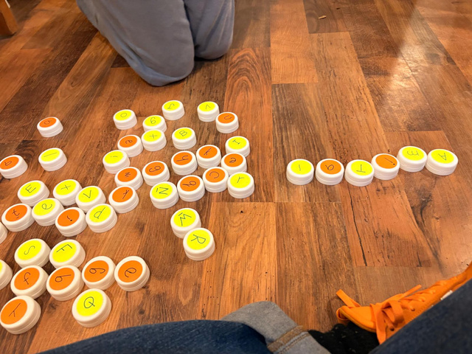


Lesson 5, letter e, sh by: Maya Harel and Haneen Badarnehs
It looks like that
h
t
p
n
s
sh
d
i
a
e

Slide 5
Lesson 5, letter e, sh by: Maya Harel and Haneen Badarnehs
H
T
P
N
S
SH
D
I
A
E

