Slide 1

Rhonda the Rhino Keeper

Slide 2
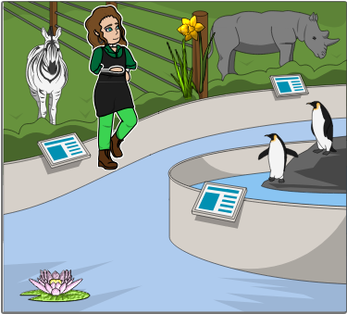
Rhonda the Rhino Keeper worked at the zoo.

Slide 3
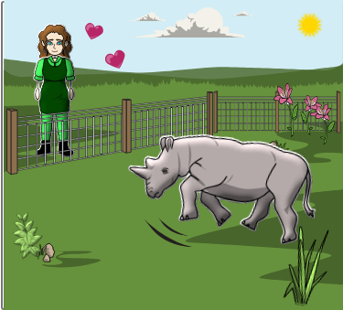
She was very fond of Rhett the Rhino.

Slide 4
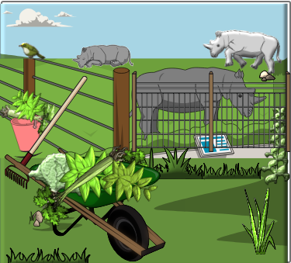
Everyday, Rhonda fed all the rhinos fresh grass and leaves.

Slide 5
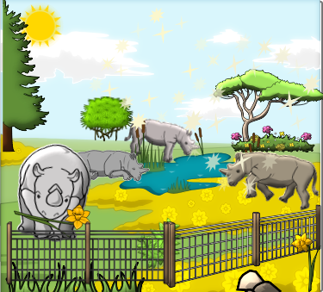
Rhet loved to eat. He tried to eat anything he could find!

Slide 6
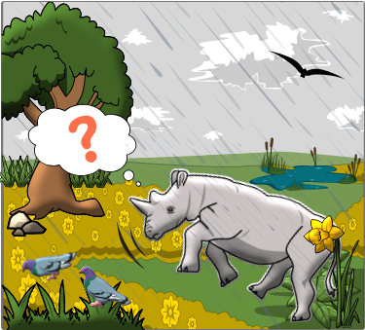
One rainy day, Rhett sniffed and poked around for something new to eat.

Slide 7
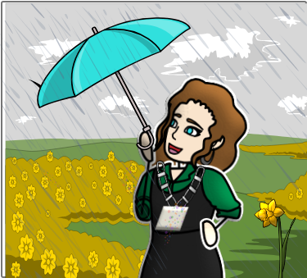
Now, Rhonda wore a chain made of rhodium with rhinestones. The chain was shiny like rain.

Slide 8

The chain had a small charm. It was in the shape of a rhombus.

Slide 9
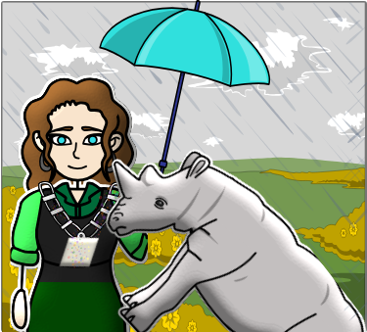
Rhett tried to lick the rhodium charm.

Slide 10
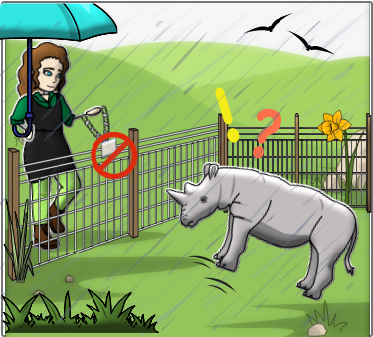
But Rhonda said, "No, Rhett! You can't eat that! Rhinestones are not a rhino snack!"

Slide 11
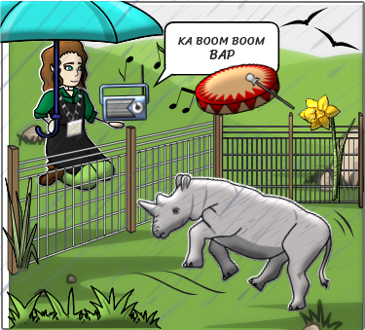
Rhonda said, "Listen, Rhett. A song with rhymes and rhythm. Rhythm is a better treat for both of us!"

Slide 12
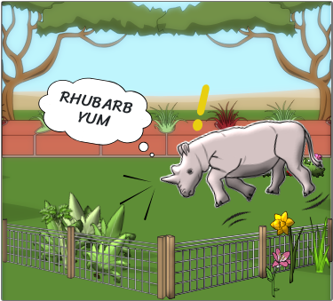
Next, Rhett snorted and sniffed around, and he found some rhubarb plants.

Slide 13
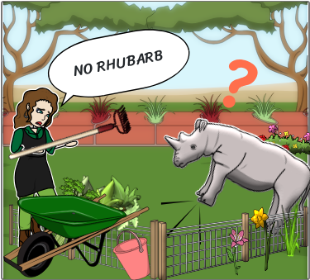
Rhonda rushed to the cage to remove the rhubarb --- just in time.

Slide 14
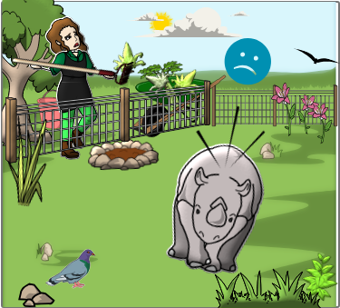
"No, Rhett!" she shouted. Rhubarb leaves are toxic!"

Slide 15
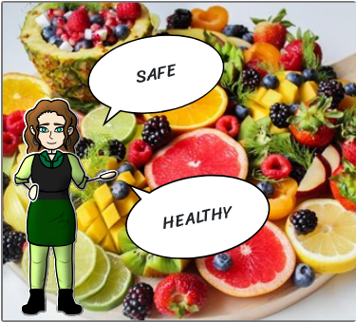
"Poor Rhett," Rhonda said. "I must help you remember what's safe to eat."

Slide 16
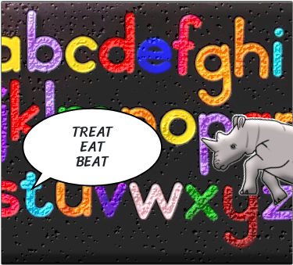
She made up a rhyme to help him remember.

Slide 17
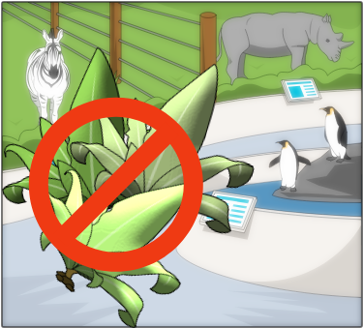
"Rhubarb is a dangerous treat."

Slide 18
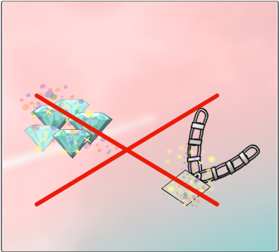
"Rhinestones are not good to eat."

Slide 19
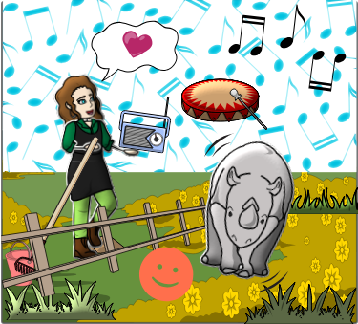
"Rhymes and rhythm can't be beat!"

Slide 20
Online game link
https://wordwall.net/resource/94431510/untitled1

Slide 21
Image Attributions
1337382 • https://www.pexels.com/photo/alphabet-letter-text-on-black-background-1337382/ • Magda Ehlers • Free To Use / No Attribution Required / See https://www.pexels.com/license/ for what is not allowed
1132047 • https://www.pexels.com/photo/sliced-fruits-on-tray-1132047/ • Trang Doan • Free To Use / No Attribution Required / See https://www.pexels.com/license/ for what is not allowed
2088203 • https://www.pexels.com/photo/photo-of-airplane-with-smoke-trail-2088203/ • eberhard grossgasteiger • Free To Use / No Attribution Required / See https://www.pexels.com/license/ for what is not allowed

