Slide 1
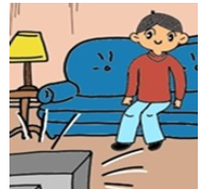
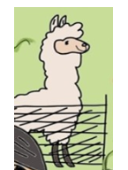
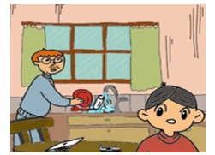
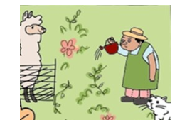
1 | pink
2 | blue
3
4
5
6 | orange
pink
Insert student’s name here
Teacher’s name
blue
green
yellow
brown
orange

Slide 2
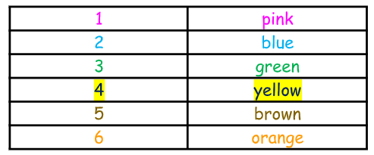
roll
stop

